Slide 1
Be like a Berean!

Slide 2
Acts 17:10-12 (KJV)
¹⁰ And the brethren immediately sent away Paul and Silas by night unto Berea: who coming thither went into the synagogue of the Jews.
¹¹ These were more noble than those in Thessalonica, in that they received the word with all readiness of mind, and searched the scriptures daily, whether those things were so
¹² Therefore many of them believed; also of honourable women which were Greeks, and of men, not a few.

Slide 3
#1. Bereans separated themselves
Berea is a gentile city. It is a place where the majority of people are non-believers, pagans, and gentiles. Yet there are a few Jews enough to establish their own synagogue. The Bereans learned how to separate themselves from the pagan practices all around them.
In like manner, Christians today live in a world ruled by Satan. We live in the midst of this cruel and evil world. Christians are expected to live in the world but NOT be part of the world.
“Do not love the world or the things in the world. If anyone loves the world, the love of the Father is not in him” (I John 2:15).

Slide 4
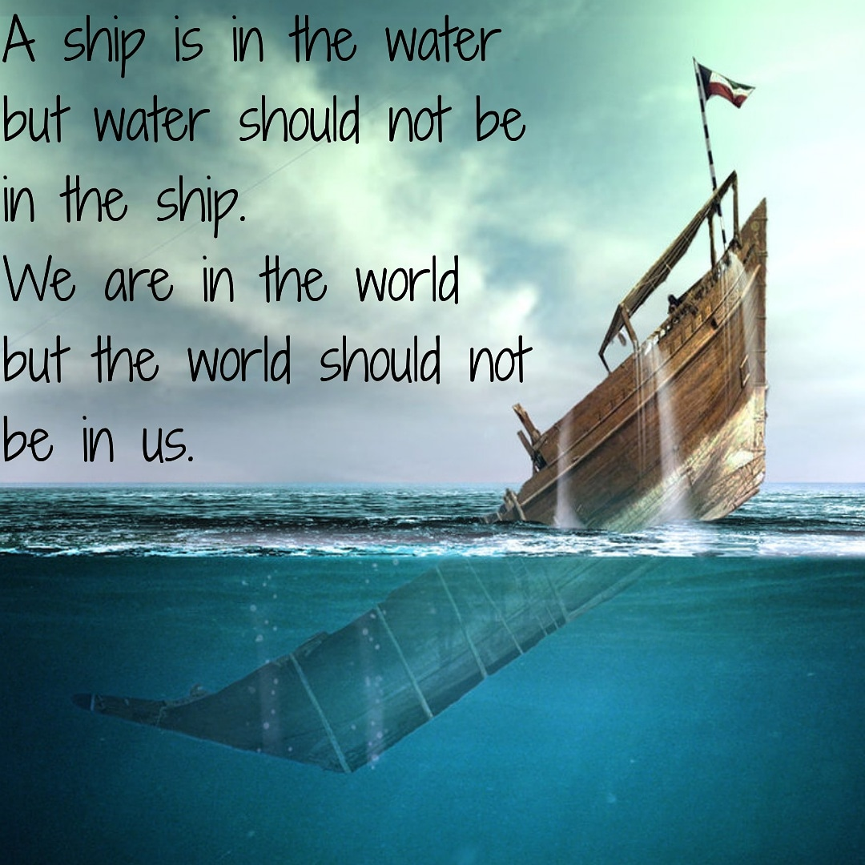
Bereans separated themselves
How do you identify the WORLD?
Watch & Pray!
Often Satan will try to sneak in with “harmless” things, little sins that don’t seem like such a big deal. It is important to be watchful.

Slide 5
#2. Bereans received the Word
"they received the word with all readiness of mind…"
…with open hearts, open minds.
Compare with: Matthew 13:15
¹⁵ For the hearts of these people are hardened, and their ears cannot hear, and they have closed their eyes—so their eyes cannot see, and their ears cannot hear, and their hearts cannot understand, and they cannot turn to me and let me heal them. (NLT)
"He that answereth a matter before he heareth it, it is folly and shame unto him." (Proverbs 18:13).

Slide 6
#3. Bereans searched the scriptures daily
“searched the Scriptures daily”…not just on the Sabbath, not just when it was convenient.
Daily, means 7 days a week – NO EXCEPTION!
We must not make any excuses. We can’t say, “We just don’t have time.” Instead, we need to say, “I must make time.” If we really have to live by the principle “Seek ye first the Kingdom of God and His righteousness,” it is a must that we make Bible study as our TOP priority.
Like a man who has not eaten for many days, we need to take, eat, and digest the words of God:
¹⁶ Thy words were found, and I did eat them; and thy word was unto me the joy and rejoicing of mine heart: for I am called by thy name, O Lord God of hosts. (Jer. 15:16)
Like a baby who is excited to suck his mother’s milk:
² As newborn babes, desire the sincere milk of the word, that ye may grow thereby: (1 Peter 2:2).
Like a deer panting for water:
¹ As the hart panteth after the water brooks, so panteth my soul after thee, O God. ² My soul thirsteth for God, for the living God: when shall I come and appear before God? (Psalm 42:1-2)
DAILY is required for growth

Slide 7
Bereans searched the scriptures daily
The Bereans evidence an energetic, passionate spirit by searching the scriptures daily.
The scriptures that were available to them were the Old Testament scriptures that were available in the synagogues. These scriptures were written on material that constituted considerable effort in searching. Yet, they did this daily!
Today, scripture is so conveniently arranged in books, chapters and verses. Bibles and study tools and the internet are available!
But we are still lazy in studying the word of God.

Slide 8
Bereans searched the scriptures daily
We are to be passionate in everything!
¹¹ Not slothful in business; fervent in spirit; serving the Lord (Romans 12:11).
In Revelation 2:1-6, Jesus warns the church in Ephesus about their lack of passion. He acknowledges all their accomplishments and hard work, and purity but says they are no longer motivated out of love.

Slide 9
#4. Bereans proved all things
What was the reason that the Bereans searched the Scriptures daily? It is to “to find out whether these things were so” (verse 11). The Bereans had the right motivation when it comes to studying the word of God. They did not do it out of rebellion, pride, or for the sake of starting an argument.
The Bereans did not believe the teachings of Paul because he was a good speaker, or he was charismatic, or because he was a friend whom they can trust. Because of their passion in searching the scripture daily and proving all things, they came to the conclusion that Paul’s teachings were true.

Slide 10
Bereans proved all things
Test/Check/Prove all things
²¹ Prove all things; hold fast that which is good. (1 Thessalonians 5:21)
¹ Beloved, do not believe every spirit, but test the spirits to see whether they are from God, for many false prophets have gone out into the world (1 John 4:1).
¹⁵ Study to shew thyself approved unto God, a workman that needeth not to be ashamed, rightly dividing the word of truth. (2 Timothy 2:15)
² I know thy works, and thy labour, and thy patience, and how thou canst not bear them which are evil: and thou hast tried them which say they are apostles, and are not, and hast found them liars (Revelation 2:2)
Proving and testing all things are not just a job of the pastor or the leaders of the church.

Slide 11
#5. Bereans influenced others for good
Because of the zeal and perseverance of the Bereans in studying the Scripture, “many of them believed, and also not a few of the Greeks, prominent women as well as men” (verse 12).
We can see that through the example of the Bereans, God used them as an instrument to call many gentiles into the Church.
Since the Bereans were fully convinced in their minds that the teachings of Paul were true, they gained confidence in what they believe. This confidence translated into their lives and other people outside the church can’t help but notice the marked changes in their lives.
Matthew 5:16 :
“LET YOUR LIGHT SO SHINE BEFORE MEN, that they may see your good works and glorify your Father in heaven.”

